Slide 1
Talk on Talks
Branislav L. Slantchev
Political Science
UCSD
Notes:
There are several types of talks, and I can tell you some specifics about them, but the points here apply to all of them: they basically differ in timing of the sections rather than content.

Slide 2
types
Talks:
Teaser (conference)
It’s complicated (workshop)
Dog & pony show (job)
Every talk is a job talk!
Notes:
Talks <20 min is an add, an invitation for the audience to read the paper. You cannot present the paper properly in its intricate glory, so don’t try. Talks ~ 35 min are the dog and pony show where you can leave the audience with the impression that they don’t have to read the paper since they understand it now so well. The workshop usually has a more accepting audience, and you can get away with presenting “work in progress”.
The talk is about presenting an idea/evidence but a job talk (and every talk is a job talk) is also about selling yourself: are you knowledgeable, collegial, sharp, quick on your feet?

Slide 3
The Deadly Sins…
Notes:
Without further ado, let me just specify the things you absolutely must avoid during a talk. If you walk out of here after these, you will have gotten the most important message (but none of the advice on how to avoid these sins!)

Slide 4
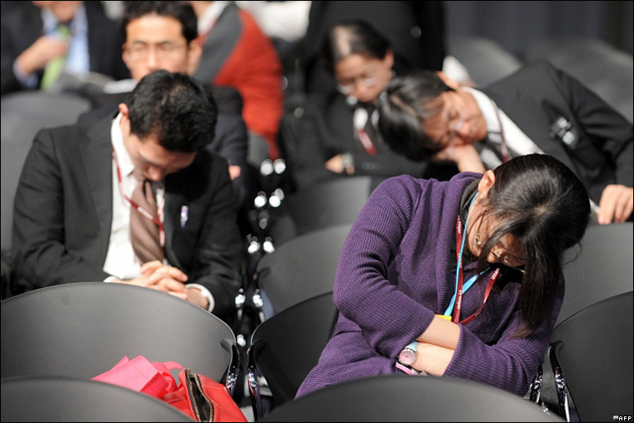
BORING
Notes:
Nothing kills a presentation as being delivered by a boring presenter. I will talk more about performance later. There’s a reason this is #1!!!!

Slide 5

CONFUSING
Notes:
If you want your audience to hate you, confuse them. Throw loads of data at them, do not interpret your charts, make an argument with more than 3 steps in it. If we can’t follow you, YOU are screwed.

Slide 6
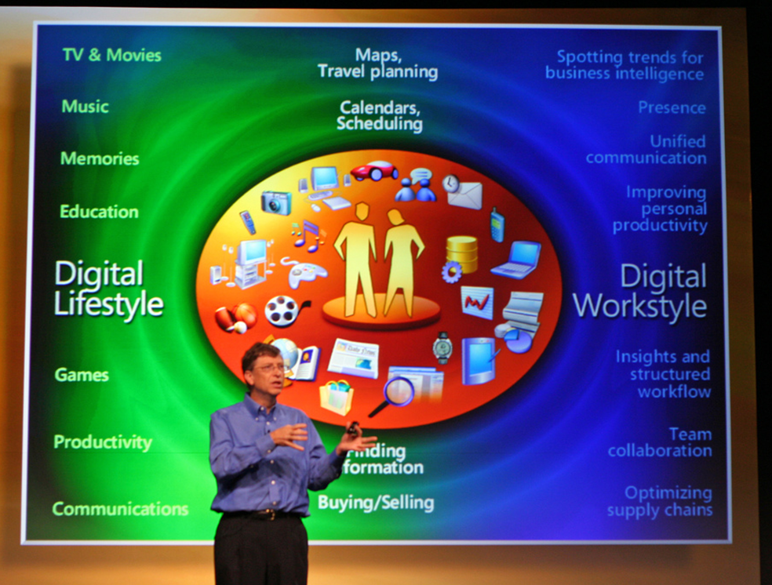
CLUTTERED
Notes:
Bill Gates can get away with it. You can’t. Stay away from ridiculously busy slides, multiple fonts, fancy transitions, sound effects, and “clever” use of colors. Put stuff in notes that the audience can’t see if you need reminders.

Slide 7
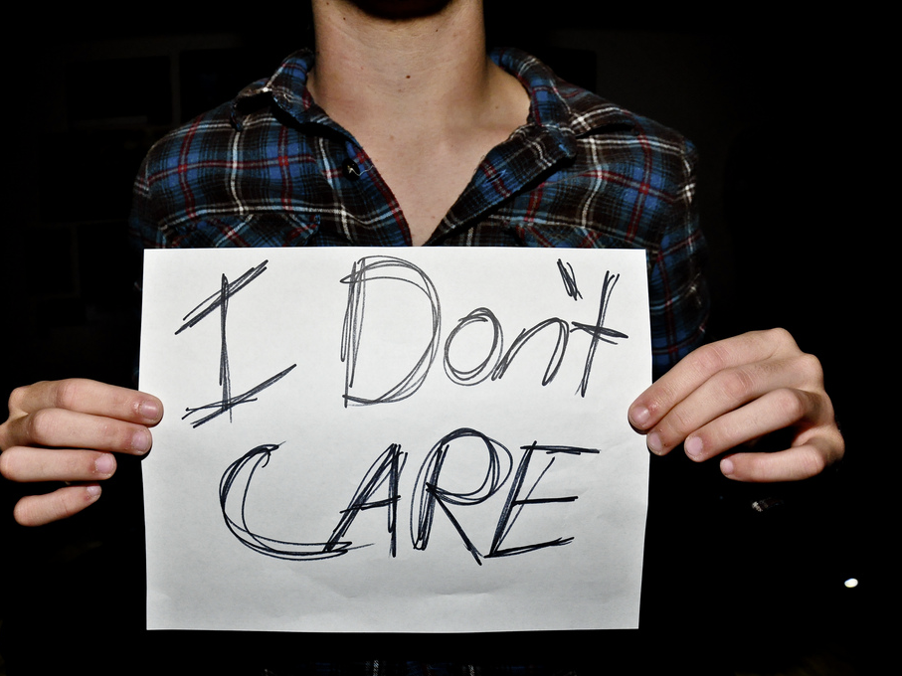
TRIVIAL
Notes:
The dreaded “So What?”: failure to answer this can be deadly. The best research will fall flat in a talk if the audience does not care about the results. What’s in it for them?

Slide 8

OVERLONG
Notes:
Do not go overtime. It’s OK to finish earlier (but not much earlier or people would think you’ve got nothing to say). Going over your time, unless it’s for a couple of minutes and it’s clear you are concluding, is bad.
Very bad.
I can’t emphasize just how bad it is. It decreases the amount of time for comments and Q&A showing that you don’t care about what your audience thinks. It is disrespectful. It frustrates people’s expectations: the audience knows when you’re supposed to finish and prepares mentally for the end; when the end does not come, most of us will get annoyed.

Slide 9

MISSING…
Notes:
Why is your question worth answering?
What is the key to your answer: what does it explain that we could not understand before AND why does it explain it
What is your evidence for your claims?
What is your “take-home” point?

Slide 10
(yes, there were only six sins.)
Notes:
I know you counted!

Slide 11
The Virtues…
Notes:
So now that you’ve learned what to avoid (quick: what are the six sins?), let’s talk about what to do.

Slide 12
content
Your Goal:
persuade
Your Strategy:
organize
Notes:
Remember that your goal is for people to walk out of the room with your take-home message:
We’re a bunch of skeptics, your job is to PERSUADE us that you are right and that what you’re doing is worthwhile
At the end of the talk, they should know what your argument was, what your evidence was, and have some sense about how convincing you were
Summarizing everything at the end is good, but keeping everyone on track throughout is better

Slide 13
content
Structure:
The puzzle
Why bother?
Your answer
The evidence
Take-home point
Notes:
After stating the puzzle (A PUZZLE!), you have to tell us why it’s important (DEADLY SIN not to).
The presentation is not an Agatha Christie detective novel where the point is revealed with great fanfare at the end; it is an exercise in persuasion where you are trying to persuade a bunch of skeptics that your argument is correct and your evidence sufficient
This means we have to know your argument as soon as possible
It is better to work toward known solutions where people know what to expect in the end than toward something nobody knows what it is
In this, a presentation is fundamentally different from how you do research but your goal is not to replicate your experience here
You then proceed to showing us the supporting evidence: proofs, stats, interpretive dances, whatever.
Don’t forget to conclude. Don’t summarize the entire talk (like people often do in papers, also bad form), but just tell us the point. What do you want us to walk away with (besides you being a fabulous presenter, a smart quick thinker, and a pleasant person to boot)?

Slide 14
content
Pet Peeves:
Long preamble
Notes:
GET TO THE POINT EARLY: what is your question? Why do we care? What is your answer?
People often ramble about their projects, their trips, even their (lack of) presentation skills. Then they tell anecdotes or lame jokes. And all the while, we’re all wondering “What, the fuck, is he going to talk about?”

Slide 15
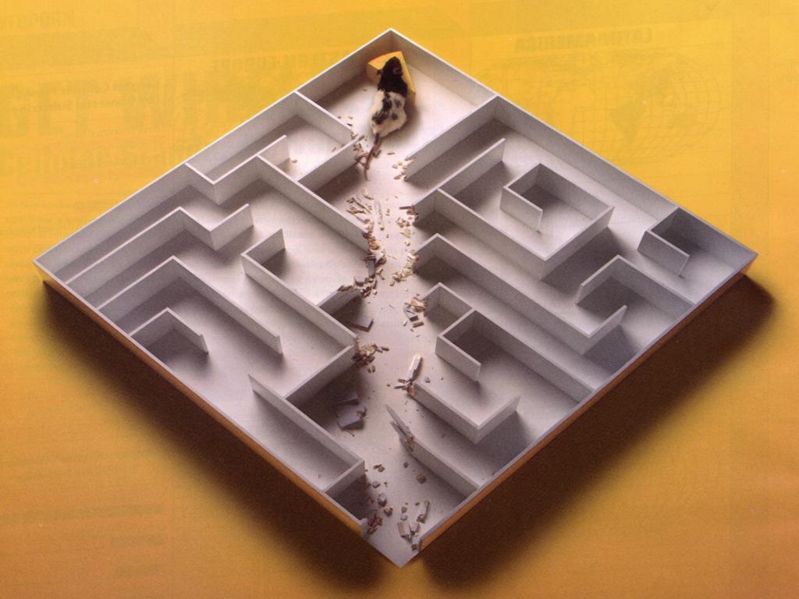
Get to the point!
Notes:
GO FOR IT!

Slide 16
content
Pet Peeves:
Long preamble
“Outline” slide
Detailed lit reviews
Mysterious entries
Excessive jargon
Notes:
Drop the “outline of the talk” slide (OK to have unobtrusive dynamic content markers, as Beamer does but not necessary). A well-structured talk (like this one!) needs no outline.
Minimize literature review:
It is not a catalog of existing work on a topic, it is a story that shows where your work fits in (why the existing work is deficient)
It is there to provide context for your work, not someone else’s
You have very little time, so do not go over all relevant work that you cite in the paper, provide key exemplars that are enough to establish the context
You do not want to run out of time and short-change your work because of the time you spent talking about everybody else’s work
Too many citations either mean you are unfocused (there’s no story) or that you are overly critical (too many people are wrong)
Explain everything on every slide! This means DON’T PUT TOO MUCH STUFF on your slides, and certainly DON’T PUT ANYTHING YOU DON’T TALK ABOUT.
When your slide has a graph or a table, tell us what point it makes and what we are supposed to be learning from it
Label everything clearly but do not rely on the audience to see in the 2 seconds it has what you know is there after staring at the figure for a month
Consider suppressing information that is not relevant to the point you are making (e.g., table with regression results can show only the variables you care about)
Minimize jargon:
If members of the audience are not intimately familiar with the jargon, every time you use a term, they have to stop listening to you so they can ask themselves what it means, then ask themselves how it relates to the stuff you’re talking about, then ask themselves whether it relates to that stuff in the way you claim it does… and by that time you’ve moved on and lost them; if they are not familiar with the jargon, you lose them immediately (and probably annoy them as well) – then, they will either interrupt you to ask about it (disrupting the flow of your talk), ignore you (bored audiences are bad), or get angry with you (aggressive audiences are even worse)
We all have to translate technical terms to connect them into a story we can understand, so why not do it for us (do not make your audience work unnecessarily)
Jargon often conceals bad reasoning: if you bandy terms about, you are not explaining anything, it’s the content of these terms and how they connect that explains; you should be able to translate the terms into simple English phrases and the connections should still make sense; this translation can often uncover that in order to use the thing the term refers to, you need other assumptions that are not satisfied in your context
It does not impress anyone except grad students, it annoys most of us

Slide 17
content
Tell ‘em thrice!
Notes:
Many people advocate saying what you’re going to tell the audience, then telling them, then saying what you told them; this is not good: it is condescending, annoying, and boring. You should summarize your argument and then work to persuade your audience of it, beating them on the head with repetitive statements of the same thing will not help.

Slide 18
design
Clear & Simple:
Use large fonts
Check spelling
Do not paste figures
Do not clutter
Avoid “cool” glitter
Notes:
Use LARGE fonts so everyone can read it (most of us are near-sighted).
Really, mistakes in slides are not easy to excuse (how long did you prepare for this talk anyway?)
Don’t paste tables/text from your paper, these usually display like crap.
Clean the slides – simplicity is the key:
Drop logos, talk title, your name, and the cutely annoying navigation buttons nobody ever uses from the slides.
Avoid PPT templates like the plague that they are, especially because they waste real estate
Do not use flashy slides:
Too much effort spent on making cool transitions, putting cute pictures, or using fancy tricks sort of implies that either you devoted more time to trivial stuff like this rather than your research or you are doing a slick sale presentation that is probably slipping by something that we, being dazzled by the presentation itself, are not supposed to notice, or both. Neither of these inferences is good for you.
It is distracting: people start to think about the effects – what is the next one going to be? how did you make that one? – instead of focusing on the content of your talk
Use effects sparingly for accents (if at all); think in dramatic terms: if your presentation is mostly plain, then a sudden effect can highlight the importance of what you’re saying; if everything is special effects, it’s cacophony
If you must use elaborate frames, overfull borders (either flashy or carrying detail nobody cares about, like your name or the name of your institution), or some cute ornaments on your slides, then at least make sure they are not taking up a lot of real estate relative to the text; slides where 2/3 of the screen is occupied by ornament are annoying and suggest a light-headed presenter

Slide 19
design
Text?
No full paragraphs
Rare complete sentences
Few bullet points
Reading = NOT listening
Words < Table < Figure
Notes:
Slides are to highlight the main points to keep everyone on track with your argument, present evidence of your claims, or illustrate your points; they are not there to make the argument for you.
They are not there as presenting props, either. Don’t treat slides as reminders to yourself about what you need to say (use hidden notes on screen, index cards, or, best of all, practice until you can do the presentation in your sleep)
Do not fill up your slides:
You should almost never have a full paragraph on a slide
You should very rarely have complete sentences
Don’t have more than about 6 bullet points
Slides with lots of text take a long time to read: while the audience is reading, it is not listening to you
Always, always consider an illustration over words.

Slide 20
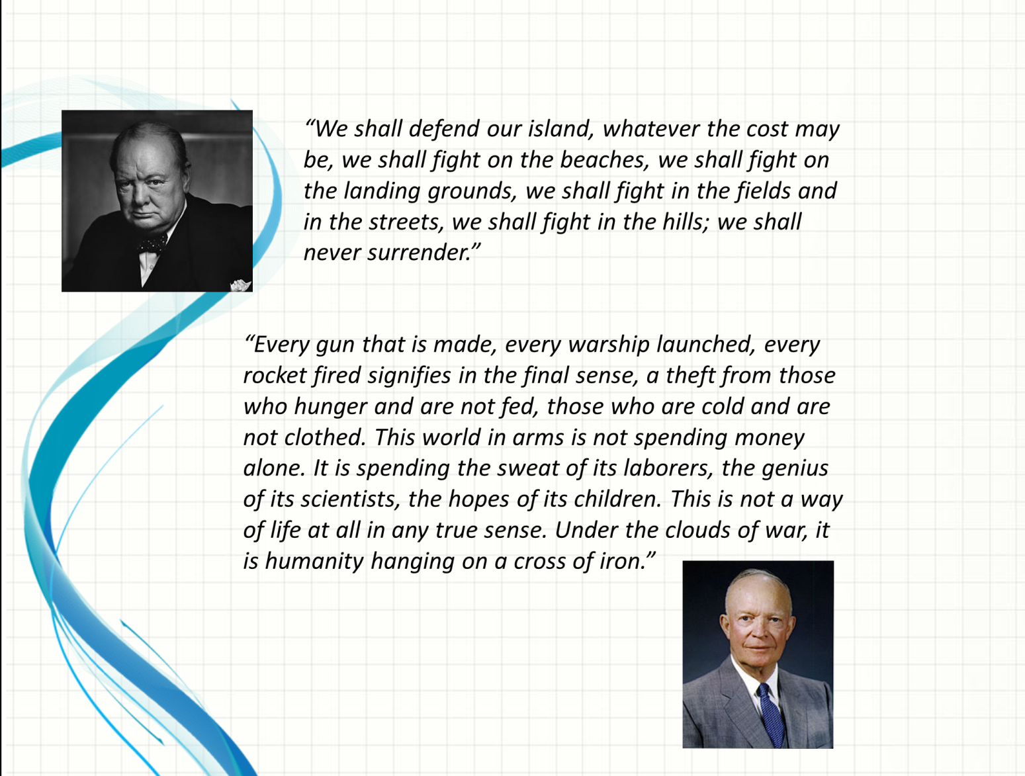
bad design
Notes:
Points:
Long quotes: reading is bad!
Photos – what’s the point?
Bad layout design
Wasted space with default background graphic
WATCH OUT FOR THE TRANSITION EFFECTS!

Slide 21
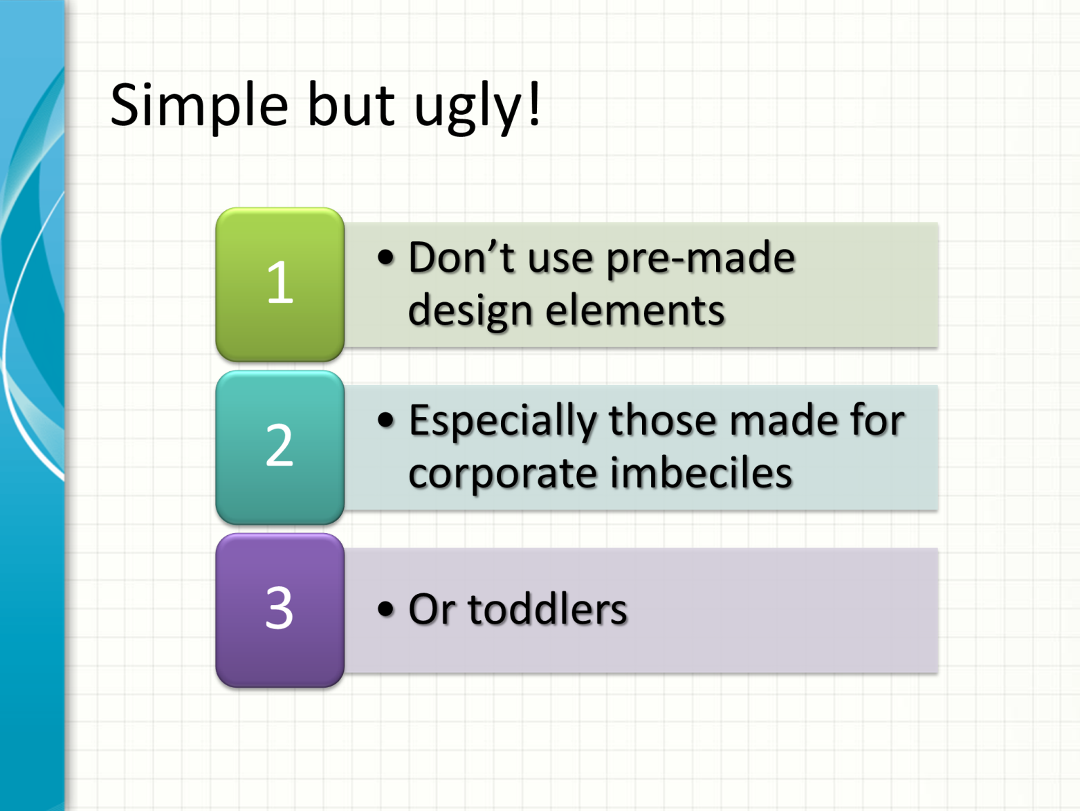
bad design
Notes:
This is what happens when you stick with templates.

Slide 22
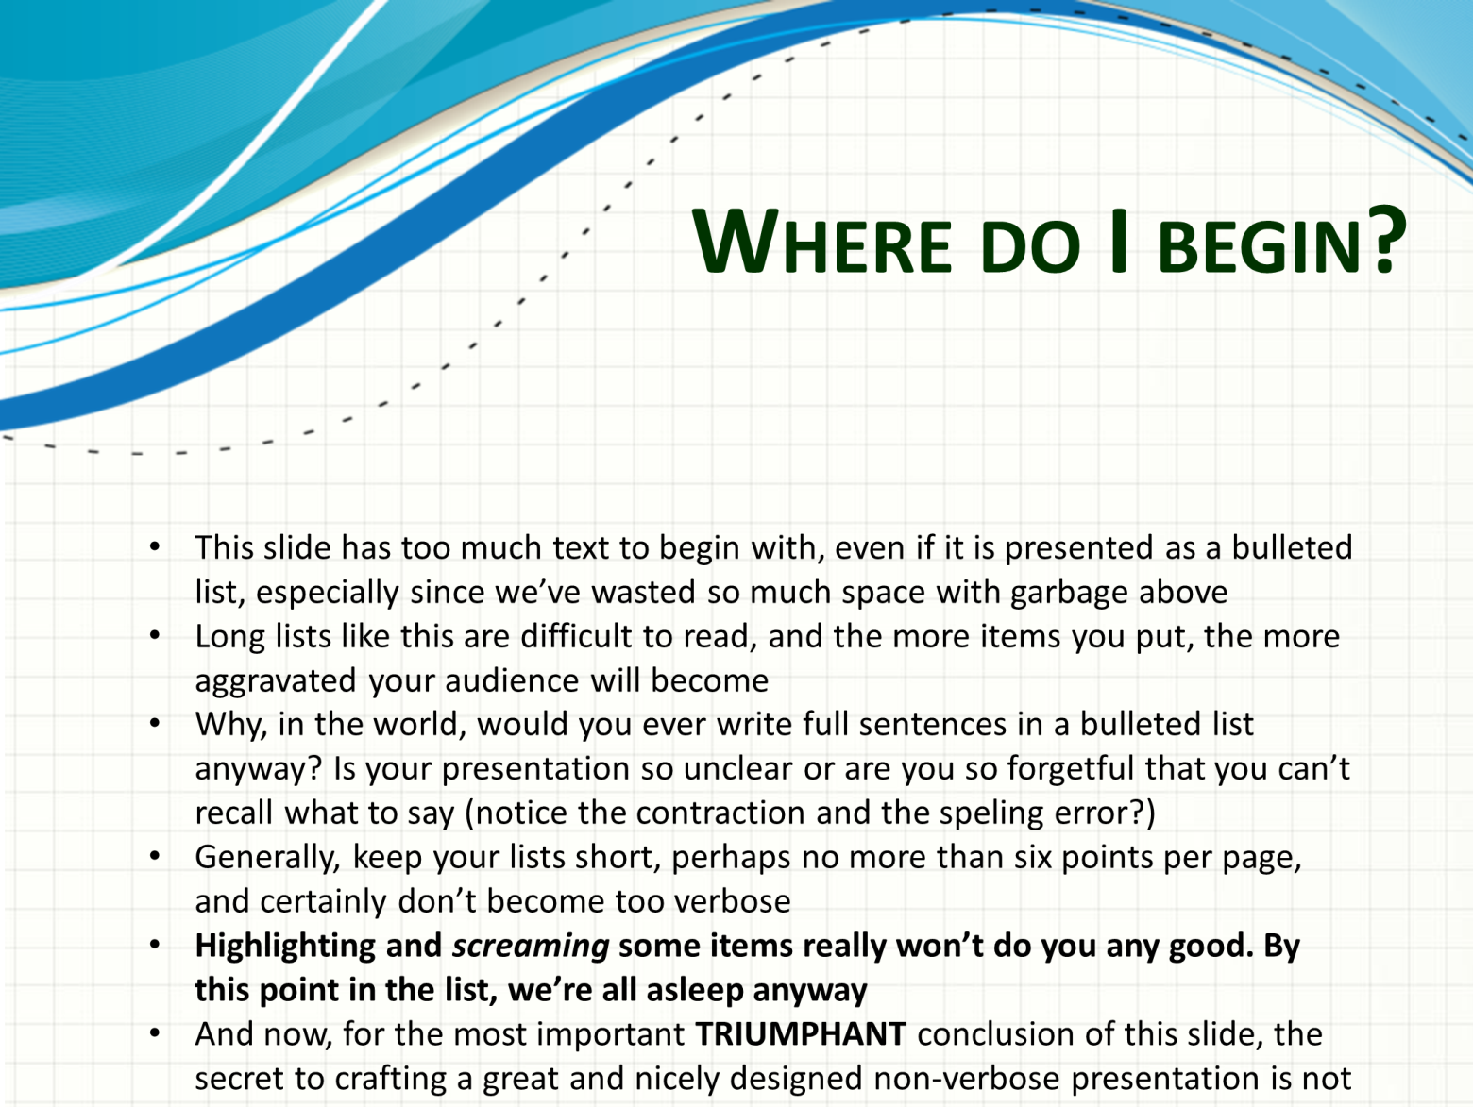
bad design
Notes:
The slide says it all

Slide 23
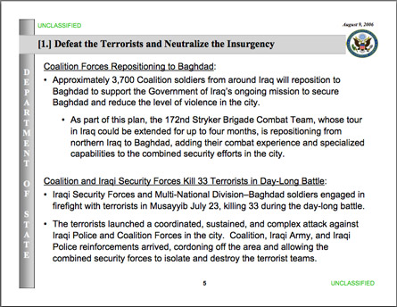
bad design
Notes:
Useless DOS banner on left
Why have the logo on every slide?
Yes, it’s UNCLASSIFIED, but is this necessary on every slide?
Date on every slide?
Bad typographic choices
Underlining????
Complete sentences (long) for bullets

Slide 24
design
Tables?
No huge tables!
Repeat, no huge tables!
Only variables of interest
Plots > Tables
Graphs > everything
Notes:
Never put huge tables:
Nobody can read them
Nobody will read them
You can’t read them either
You nod, but too many people do this, so I will repeat it
Don’t include variables you won’t discuss (controls, etc)
OK to have a slide at end to show, if someone asks
Don’t pretend results robust to controls when they are not
Plots can say it better than tables
Not too ugly even with controls
But still better to focus on relevant material only
Substantive effects with confidence intervals are by far the best!

Slide 25
bad design
Model | (1) | (2) | (3) | (4)
Preference Similarity | 0.029* (0.017) |  | 0.029* (0.017) | 0.031* (0.017)
MAI Efficiency |  | 0.079** | 0.101** | 0.105**
 |  | (0.033) | (0.040) | (0.043)
Unemployment | 0.008 | -0.005 | -0.001 | -0.002
 | (0.012) | (0.010) | (0.013) | (0.014)
GDP Growth | -0.006 | 0.011 | 0.005 | 0.014
 | (0.016) | (0.013) | (0.018) | (0.021)
GDP Per Capita | 0.0001*** | 0.0001*** | 0.0001*** | 0.0001***
 | (0.000) | (0.000) | (0.000) | (0.000)
Govt. Expenditure | 0.115*** | 0.144*** | 0.134*** | 0.133***
 | (0.013) | (0.013) | (0.014) | (0.014)
Relative Income | 1.735*** | 2.121*** | 1.986*** | 1.984***
 | (0.311) | (0.369) | (0.350) | (0.351)
# Major Powers | 0.233*** | 0.208*** | 0.232*** | 0.243***
 | (0.028) | (0.033) | (0.032) | (0.033)
U.S. Membership | 0.194 | -0.139 | -0.219 | -0.256
 | (0.164) | (0.187) | (0.192) | (0.194)
MAI Age | -0.000 | 0.012** | 0.015** | 0.015***
 | (0.005) | (0.006) | (0.006) | (0.006)
Post Cold War | 0.873*** | 0.656*** | 0.827***
 | (0.110) | (0.109) | (0.133)
# Disaster Deaths | 0.000 | 0.000 | 0.000 | -0.000***
 | (0.000) | (0.000) | (0.000) | (0.000)
Time Trend | 0.003 | -0.066* | -0.076*
 | (0.038) | (0.038) | (0.042)
Constant | -3.047*** | -3.097*** | -2.911*** | 0.000
 | (0.359) | (0.348) | (0.442) | (0.000)
Period Fixed Effects | N | N | N | Y
Observations | 1972 | 1961 | 1659 | 1659
Government-MAI-N | 368 | 308 | 303 | 303
R² | 0.12 | 0.15 | 0.13 | 0.13
Notes:
This is what people often do (and this is OK formatted, actually: at least the variables have names, not codes)

Slide 26
better design
Model | (1) | (2) | (3)
Preference Similarity | 0.029* (0.017) |  | 0.029* (0.017)
MAI Efficiency |  | 0.079** | 0.101**
 |  | (0.033) | (0.040)
[Control variables omitted]
Period Fixed Effects | N | N | N
Observations | 1972 | 1961 | 1659
Government-MAI-N | 368 | 308 | 303
R² | 0.12 | 0.15 | 0.13
Notes:
Simpler table, only the main variables of interest, missing title.

Slide 27
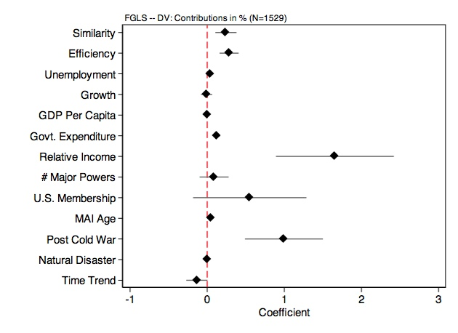
better design
Notes:
Still missing a title for the figure though, still too many variables that won’t be talked about.

Slide 28
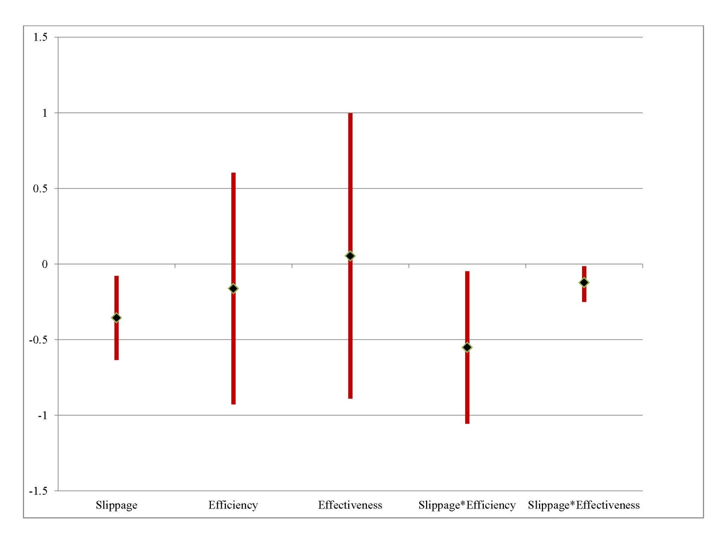
best design
Commitments to multilateral aid institutions
Notes:
Nice: plot shows only variables relevant to the argument.

Slide 29
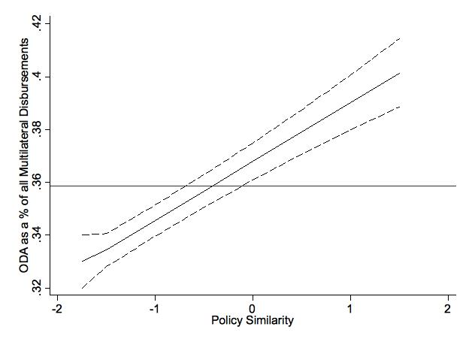
bestest design
Notes:
Best: shows both substantive effect & statistical significance!

Slide 30
delivery
Do not:
Sit down
Read
Talk to screen or ceiling
Talk down to audience
Fake humility
Notes:
Do not present sitting down; present standing and move around, point to your slides, use gestures, vary the pitch of your voice
When you sit down, you are passive, your tone becomes passive, and everyone goes to sleep
When you sit down, you are tempted to read rather than talk (see below)
When you sit down, people have difficulty seeing you in most cases
When you sit down, you fail to establish your presence (dominance?) in the room, and you will have difficulty maintaining control of the presentation
Do not read:
Do not read your slides, we can read them just fine
Do not read your notes, written language is more complex than spoken, and is harder for the audience to follow
Written notes are often too verbose and ornate; use plain language and avoid rhetorical flourishes when they do not contribute to your argument (or use sparingly for dramatic impact)
Written sentences are longer than what we can comfortably process while listening: when reading, you can always go back, re-read, pause and think about the unclear parts; when listening, when you lose the track, you lose it all and you cannot recover in time; in the time your audience recovers the train of thought, you do not have them
Use simple declarative sentences; avoid multiple conditionals; if you have to use them, put them on the slide so the audience can keep track
Reading is passive, you are ignoring your audience (and you cannot pay attention to their reactions, read body language, and adjust your speech accordingly)
Most people are very monotonous when they read, which makes the presentation boring
You cannot make eye-contact with your audience, which makes them feel ignored and may discourage clarifying questions (they might be hesitant to interrupt)
Talk to the audience, not the laptop, the screen, or the ceiling
You have to monitor body language to know how to vary delivery and whether you are losing them
You have to keep them engaged in your talk (eye-contact prevents many from drifting off into checking e-mails and such)
This shows you are enthusiastic about your work (which is contagious, see below)
Don’t talk down to your audience. We’re a sensitive bunch, and if you appear to be treating us like morons, we’re apt to take offense even if (or maybe especially if) we truly do not understand what you’re talking about on a very basic level. Similarly, don’t go overboard and be so difficult and demanding that nobody actually understands you. The best talk is pitched slightly above the average intelligence in the room. No, I have no idea how to figure out what that is.
Don’t start by prostrating yourself and being (falsely) too humble. Similarly, don’t start by making bombastic claims or boldly thrashing some else’s work.

Slide 31
delivery
Do:
Be excited, smile
Perform
Control the room
Skip meta-comments
Close properly
Notes:
Be excited about what you are doing:
This may be old stuff for you, but it is not for the audience, pretend this is the first time you are presenting your cool arguments/results
Excitement is contagious and so is boredom: if you are listless, you are communicating that your topic is boring and if you don’t care about it, why should we?
When you are enthusiastic and your audience thinks you are smart, they get interested: after all, here’s an intelligent person who seems quite taken with the topic, so there must be something neat going on
Perform!
You have about 30 seconds to make an impression (http://kev.inburke.com/pdf/30_seconds_teacher_quality.pdf)! Don’t frown, don’t fidget with hands or objects, don’t stick your hands in your pockets. Be active, confident, and smile. Your goal is to look competent and likeable.
Part of being convincing is being entertaining: if people are bored, they will ignore what you are saying and drift off
Well-placed jokes (this has to come to you naturally, if it doesn’t you should probably not try it), well-modulated delivery (you can train yourself to do it), body-language, eye-contact, projecting comfort with your knowledge (but not arrogance), all are important ingredients in establishing you as an authoritative source which can potentially be trusted
Academics are among the most skeptical audiences you can encounter, do not make your life harder by making them unwilling to listen to your arguments, they are already predisposed to think you are wrong
Try to put some of your abstract arguments in concrete terms, use examples (if you can swing it, humor here is great too)
Control the presentation:
do not allow yourself to get sidetracked by stray comments, get bogged down into an interminable exchange with an insistent audience member, or get derailed or upstaged by the monologue of an audience member. Norms of collegiality may prevent the person chairing the presentation (if there is one) from stepping in to put you back on track, and you may be on your own doing that.
Establish clear rules at the outset (e.g., clarifying questions during talk OK, substantive discussions and comments only after you are done).
Enforce the rules (without being rude). A good rule of thumb is not to take more than two consecutive questions during the presentation itself: you risk being victimized by a feeding frenzy mentality.
Focus on the question (see also Q&A). Don’t appear to be thinking about what you’re going to say next while they are asking it!
It’s OK to pause for a second or two to collect your thoughts. It’s OK to let the audience have a second or two to grasp what you just said. Don’t fill in these useful silences with “Ummmmm…”. I usually just stare at the ceiling when I do this to avoid being distracted by eye contact and avoid the appearance of inviting comments. But this might look weird, I don’t know.
Avoid “meta-comments” on your talk. If you are running out of time, silently skip slides, there’s no need to alert everyone to your bad planning. Don’t say that a slide is awful (e.g., table is too big to fit, or font too small to read). If it is, correct it. If it isn’t, why are saying it?
Close properly. Either say “Thank you” or “And with this, I am now ready to take your questions and comments”. You need to let them know you’re done. The thank-you works better when you expect applause. My approach works better when you’re supposed to launch into a Q&A. Watch out the ending: do not trail into silence. End with a bang!

Slide 32
q & a
When you know:
Recall deferred questions
Control the room
Focus on question
Do not interrupt
Be respectful…
Notes:
Handling Q&A:
Make sure you come back to any question you deferred during the talk; if you can’t remember them (b/c you’re too nervous, for example), write a brief note to yourself before continuing the talk, and then go back to the note. Do not promise and then fail to talk about a question: the person who asked you will remember, and so will many others.
Repeat the question, possibly paraphrasing it, so that everyone knows what you’re answering. Often audience members are not very audible to others.
As with the advice during the talk, control the Q&A. Do not let a single audience member hijack the discussion. Rule of thumb is to answer the question, and if there’s a follow-up, answer that, and then move on (re-direct to new topic). People in the audience are probably already annoyed at that member who’s monopolizing the discussion, especially with those with a monologue with no question in sight.
Focus on the question being asked: don’t look like a social moron by appearing to think of something else while someone is talking to you.
Don’t interrupt even if you have understood the question already. Nod to indicate you’re following but make sure you don’t look impatient.
Be respectful. It’s the right thing to do, and it’s the smart thing to do. You don’t know who’s asking (I’ve been mistaken for a student occasionally, and my question brushed aside as unworthy of comment). You might have misunderstood the depth of the question, so it’s really interesting/harder. Even if it is a silly question, just answer it and perhaps extend the answer into an interesting direction that might gratify the person who asked it and give you opportunity to engage more interesting things. Sometimes this might be hard… OK to fantasize:

Slide 33
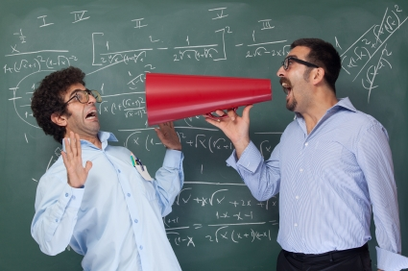
q & a
(obnoxious questions inevitable!)
Notes:
You will get them!

Slide 34
q & a
When you don’t:
Admit it
Ask for clarification
Construct an answer
Do not pretend to know
Do not apologize
Notes:
You should be prepared for most questions (from your practice talks) and hopefully you have extra slides to back up your answers. Still, there will be times when you are stumped. Then:
We don’t expect you to be omniscient. OK not to know.
If you don’t understand the question, ask for clarification
OK not to know but not OK to stop at that. Attempt to construct one. At this point you are improvising, thinking out loud, and it might not lead anywhere near an answer. However, you will have shown readiness to engage, you will have shown a glimpse of your qualities as a thinker, and perhaps you will have something that might look like a beginning of an answer.
Do not pretend to know the answer! Do not pretend to have run extra regressions and that the “results are basically the same”. If you have robustness checks, show the slide. If not, shut up.
Do not apologize for not knowing the answer. You’re not omniscient. And neither are the people in the audience.
Write down the question that stumped you, and follow through with the person who asked you after the talk if possible, and certainly when you’ve had a chance to think it through and offer something more.

Slide 35
q & a
Remember:
not knowing: OK
not engaging: NOT OK

Slide 36
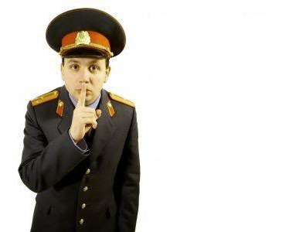
and the secret to a great presentation is...

Slide 37
PRACTICE! (a lot)

Slide 38
(the end.)

